Slide 1
EP760 application scenarios
Sandy 20240312

Slide 2
1. EP760+1B500 2. 2EP760 Grid+Backup parallel 3. Self Consumption mode 4. Time Control mode 5. Off Grid mode 6. Off-line ups mode 7. DC Coupled 8. AC Coupled 9. Manual Generator 10.EMS Touch screen 11.Install outside
Content

Slide 3
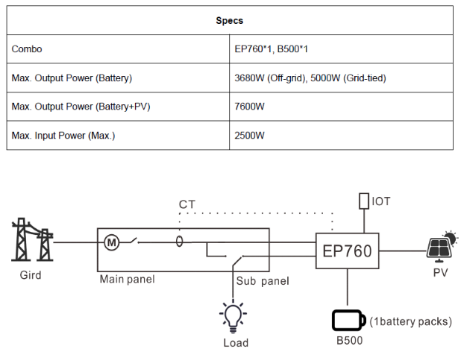
1. EP760+1*B500
Specific application scenarios
EP760 comes with only one B500 battery pack
Main performance parameters
High cost performance ratio
Accessory SKU
Standard configuration

Slide 4
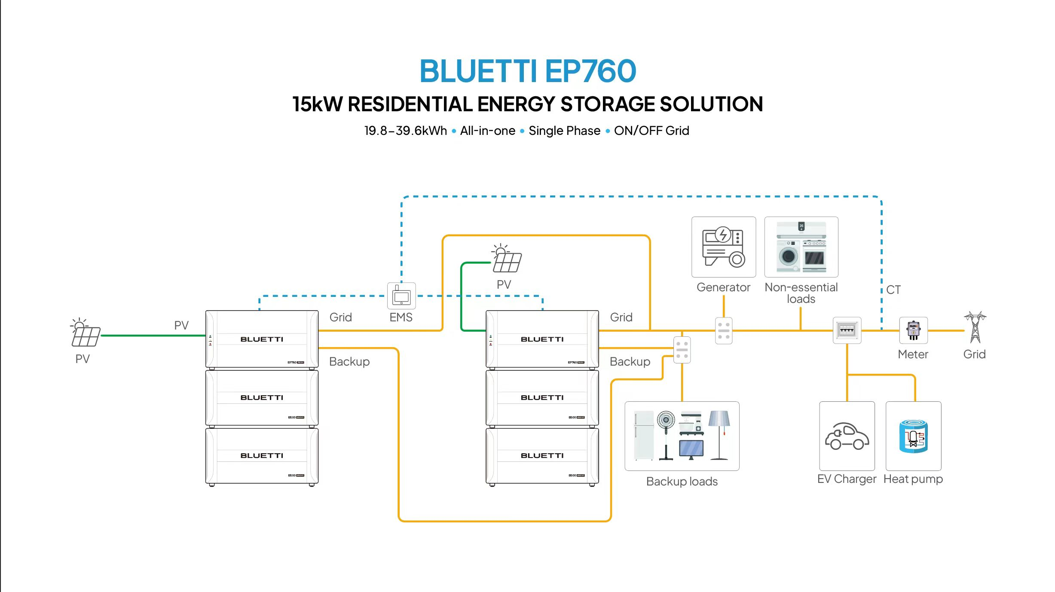
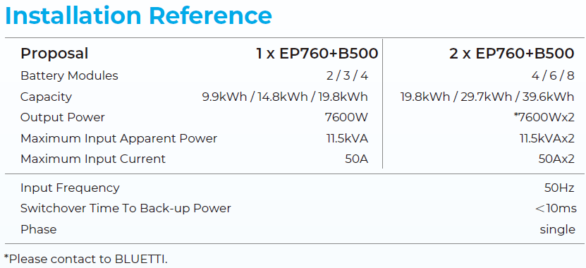
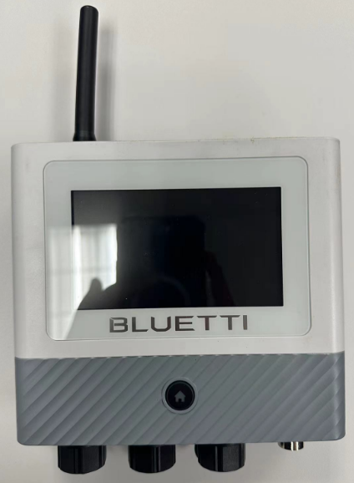
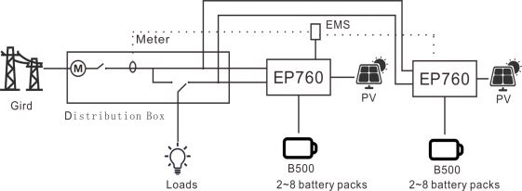
2. 2EP760 Grid+Backup parallel
Specific application scenarios
Two sets of EP760+2 * B500 or two sets of EP760+3 * B500 or two sets of EP760+4 * B500 can achieve parallel power on off grid side only, achieving power doubling and capacity doubling.Need to push parallel firmware.
Main performance parameters
Single phase 15KW output, 6MPPT, photovoltaic 18kw input, battery 19.9/29.9/39.8kWh
Accessory SKU
19.0704.0296-00（EMS+Meter）1pcs

Slide 5
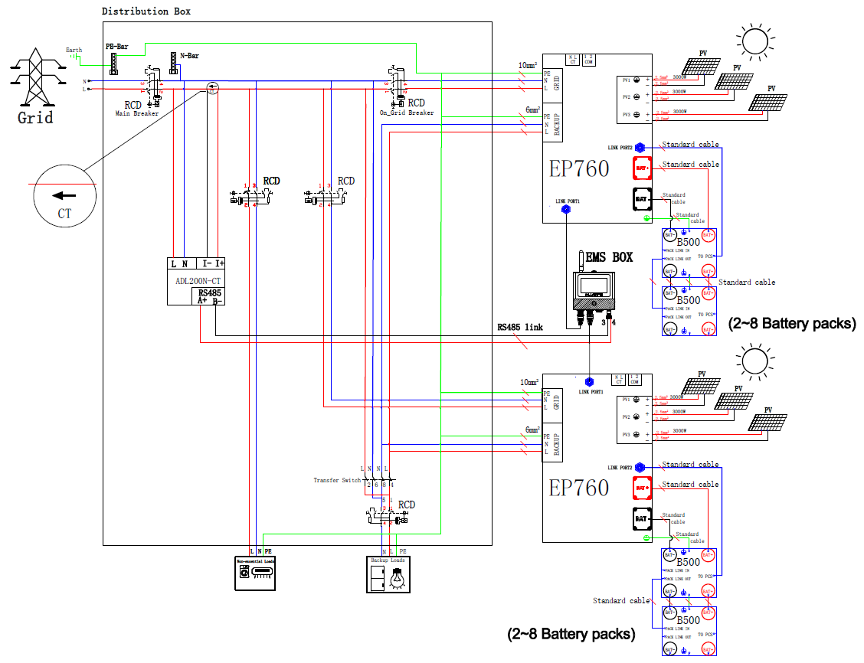
2. 2EP760 Grid+Backup parallel

Slide 6
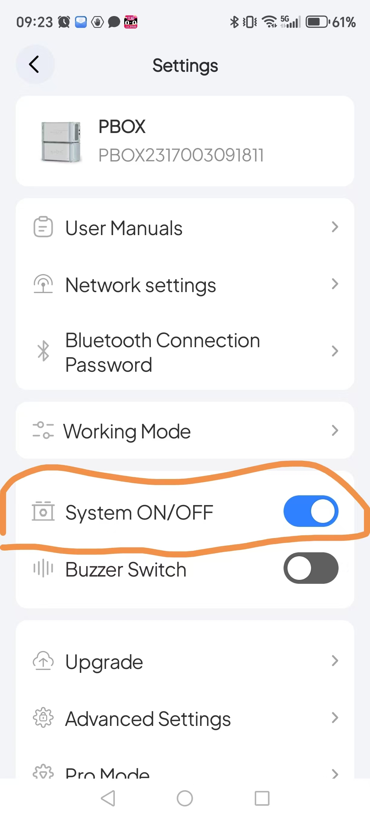
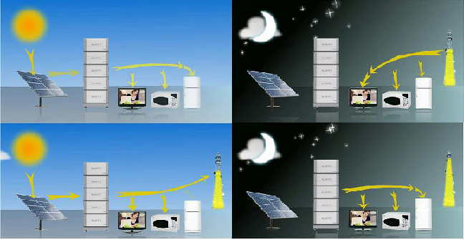
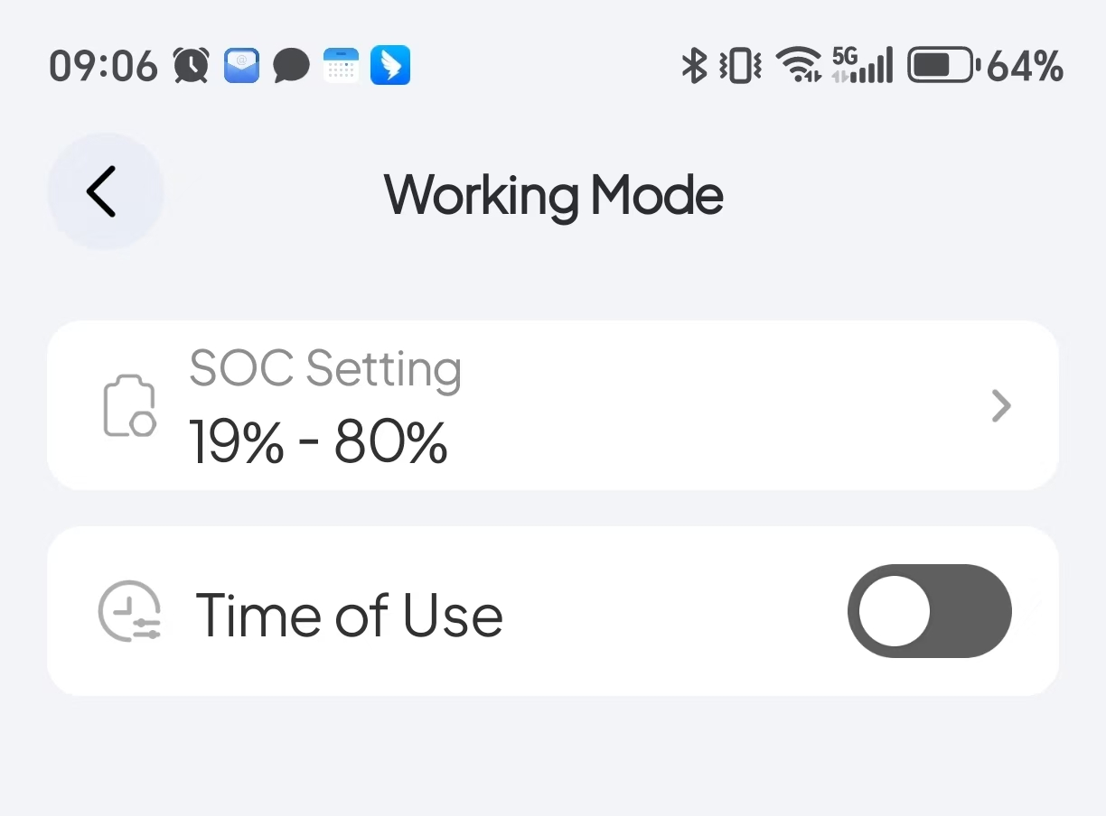
3. Self Consumption mode
Specific application scenarios
Pv generation is prioritized for load use, and the excess energy is used to charge the battery and then output to the grid to increase the pv self-use rate and save money.
Accessory SKU
Standard configuration
Default mode is self consumption
no need set any parameter except turn on the system ON/OFF switch

Slide 7
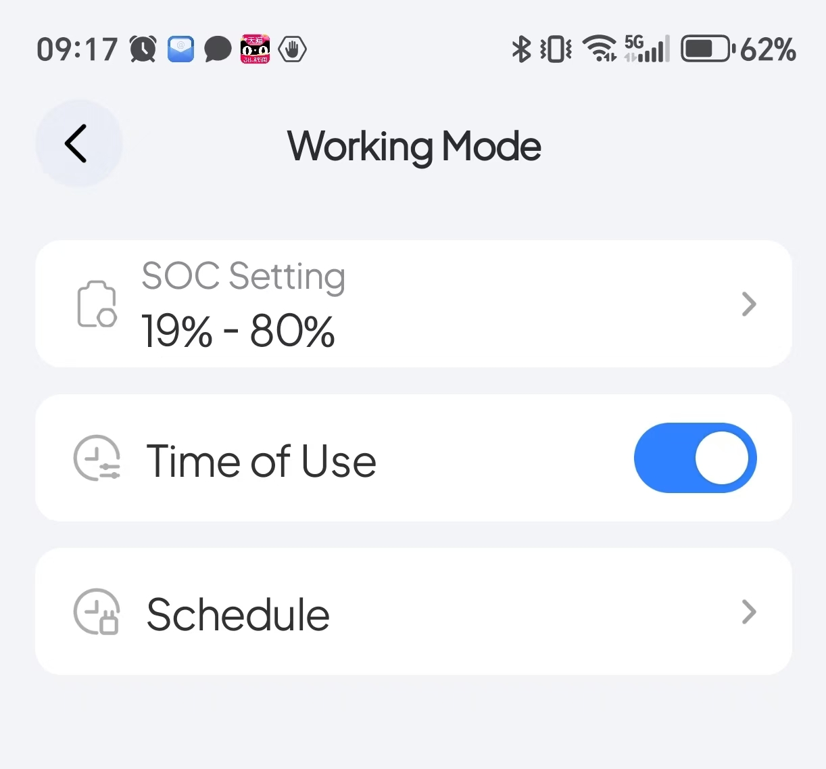
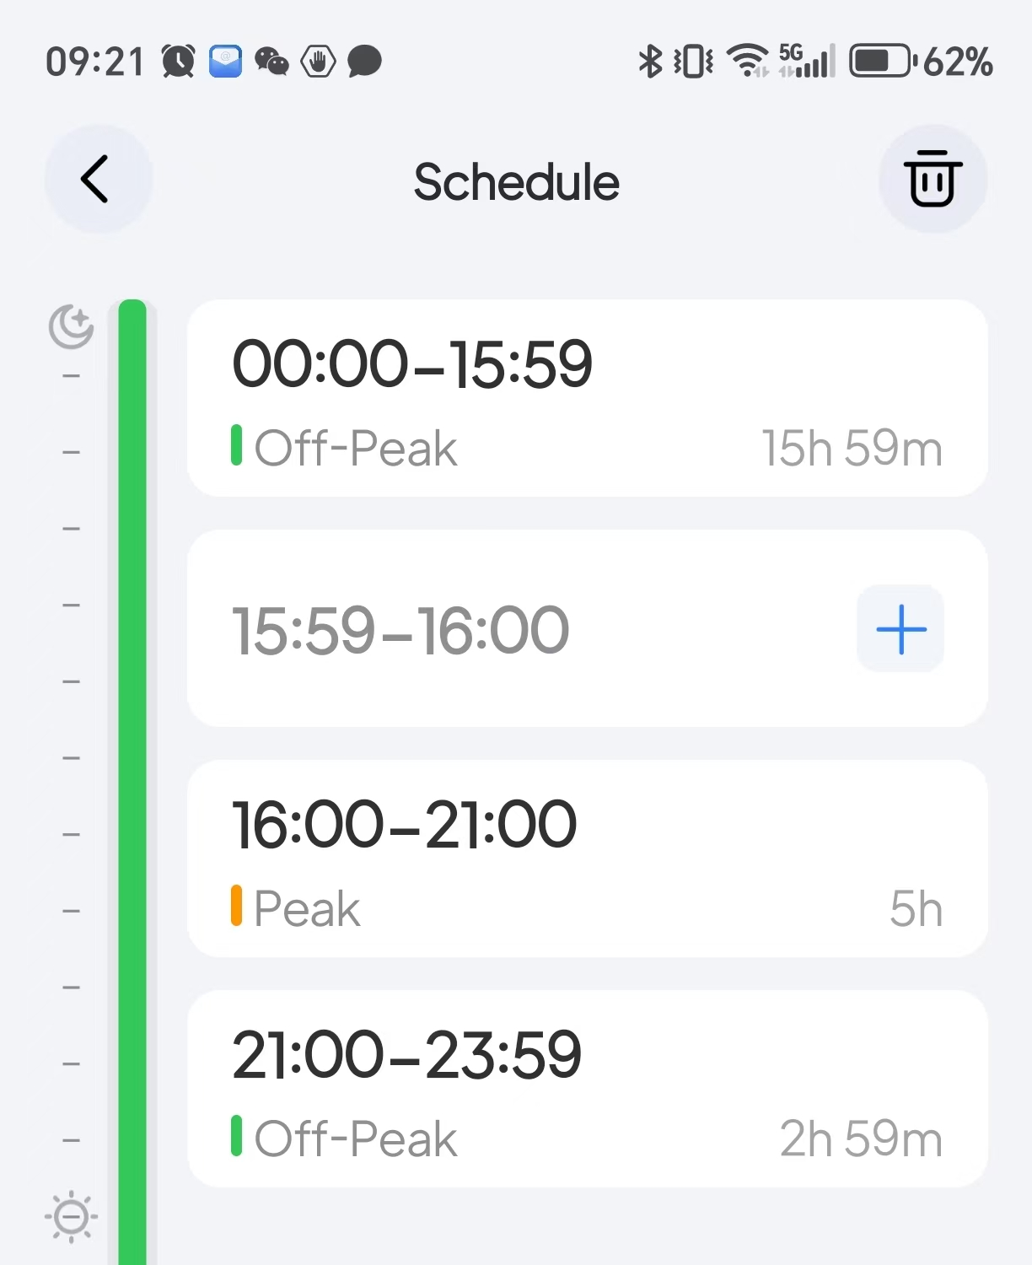
4. Time Control mode
Specific application scenarios
In areas where the difference between peak and off-peak electricity prices is large, the purpose of saving money is achieved.
Accessory SKU
Standard configuration

Slide 8
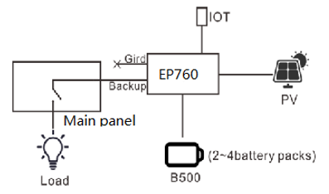
5. Off Grid mode
Specific application scenarios
No grid, only connected to PV for off grid applications.No grid and sun good area
Accessory SKU
Standard configuration

Slide 9
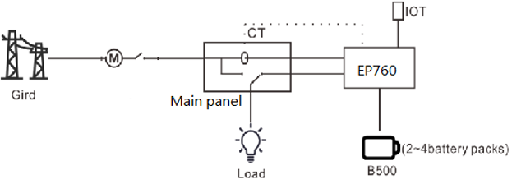
6. Off-line ups mode
pecific application scenarios
No PV, only connected to grid for UPS application.Unstable grid for UPS mode in 10ms
Accessory SKU
Standard configuration

Slide 10
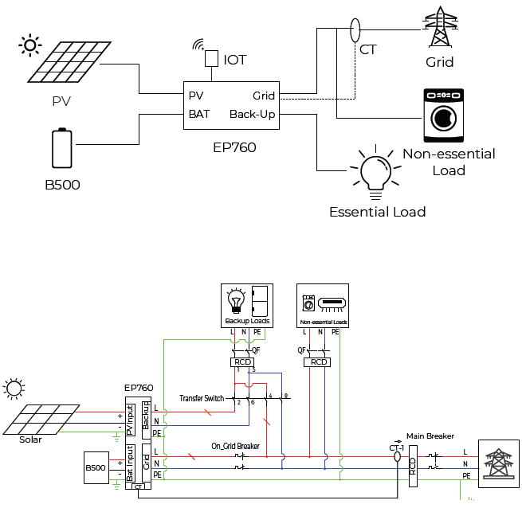
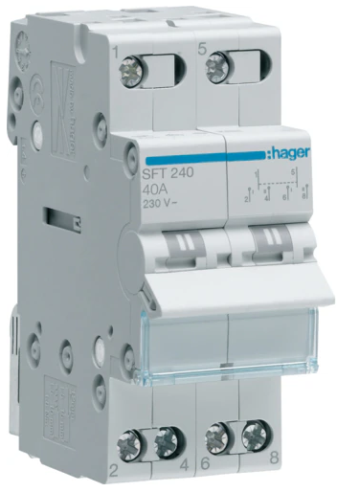
7. DC Coupled
Specific application scenarios
for new installation solar panels
Accessory SKU
Standard configuration
SFT240

Slide 11
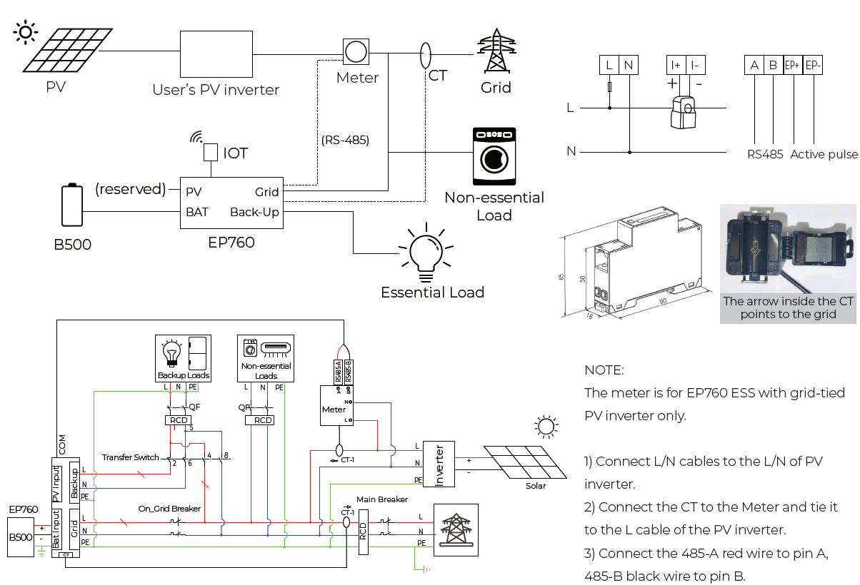
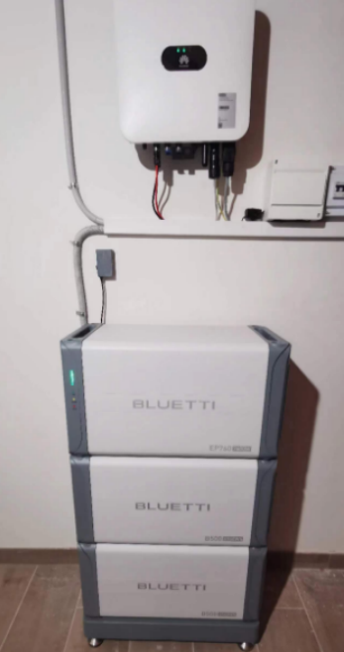
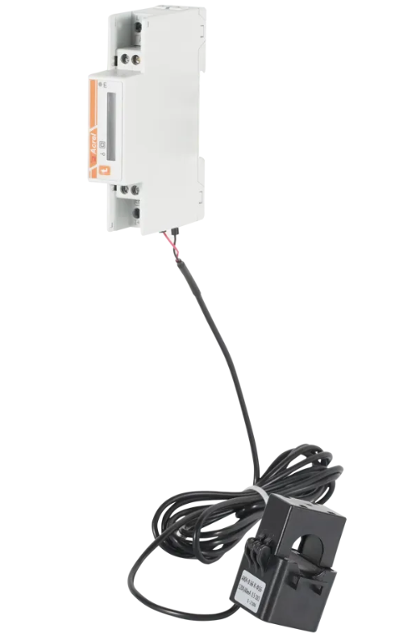
8. AC Coupled
Specific application scenarios
AC Coupling with pv inverter
Accessory SKU
29.0101.0151-00 ADL200N-CT 1pcs

Slide 12
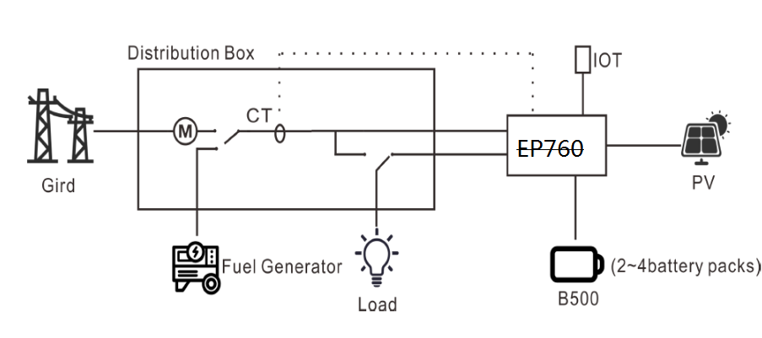
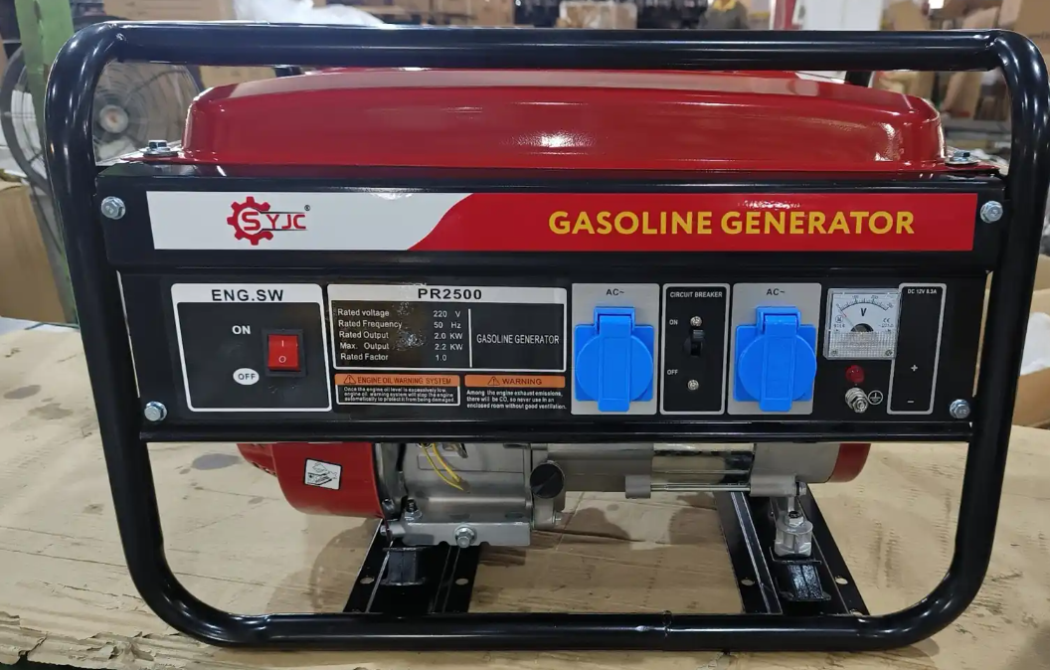
9. Manual Generator solution
Specific application scenarios
Generator charges EP600 and power load
Accessory SKU
Standard configuration

Slide 13
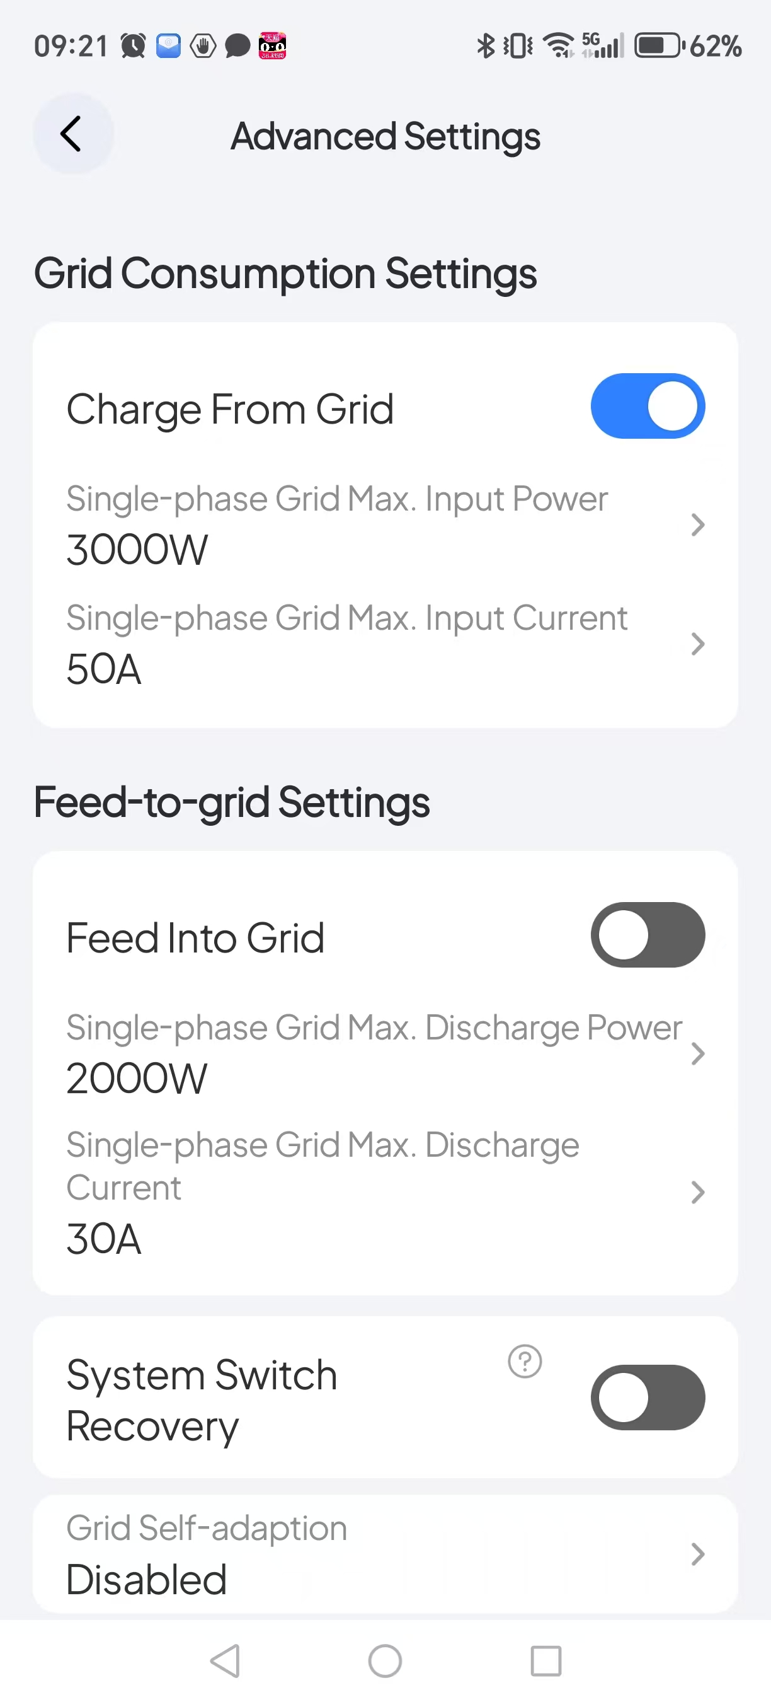
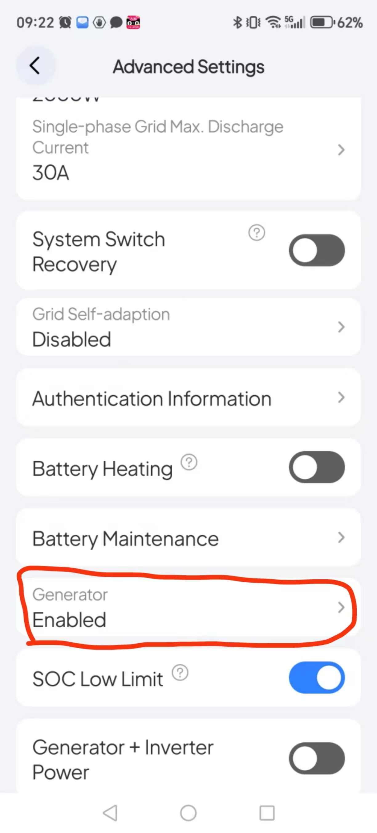
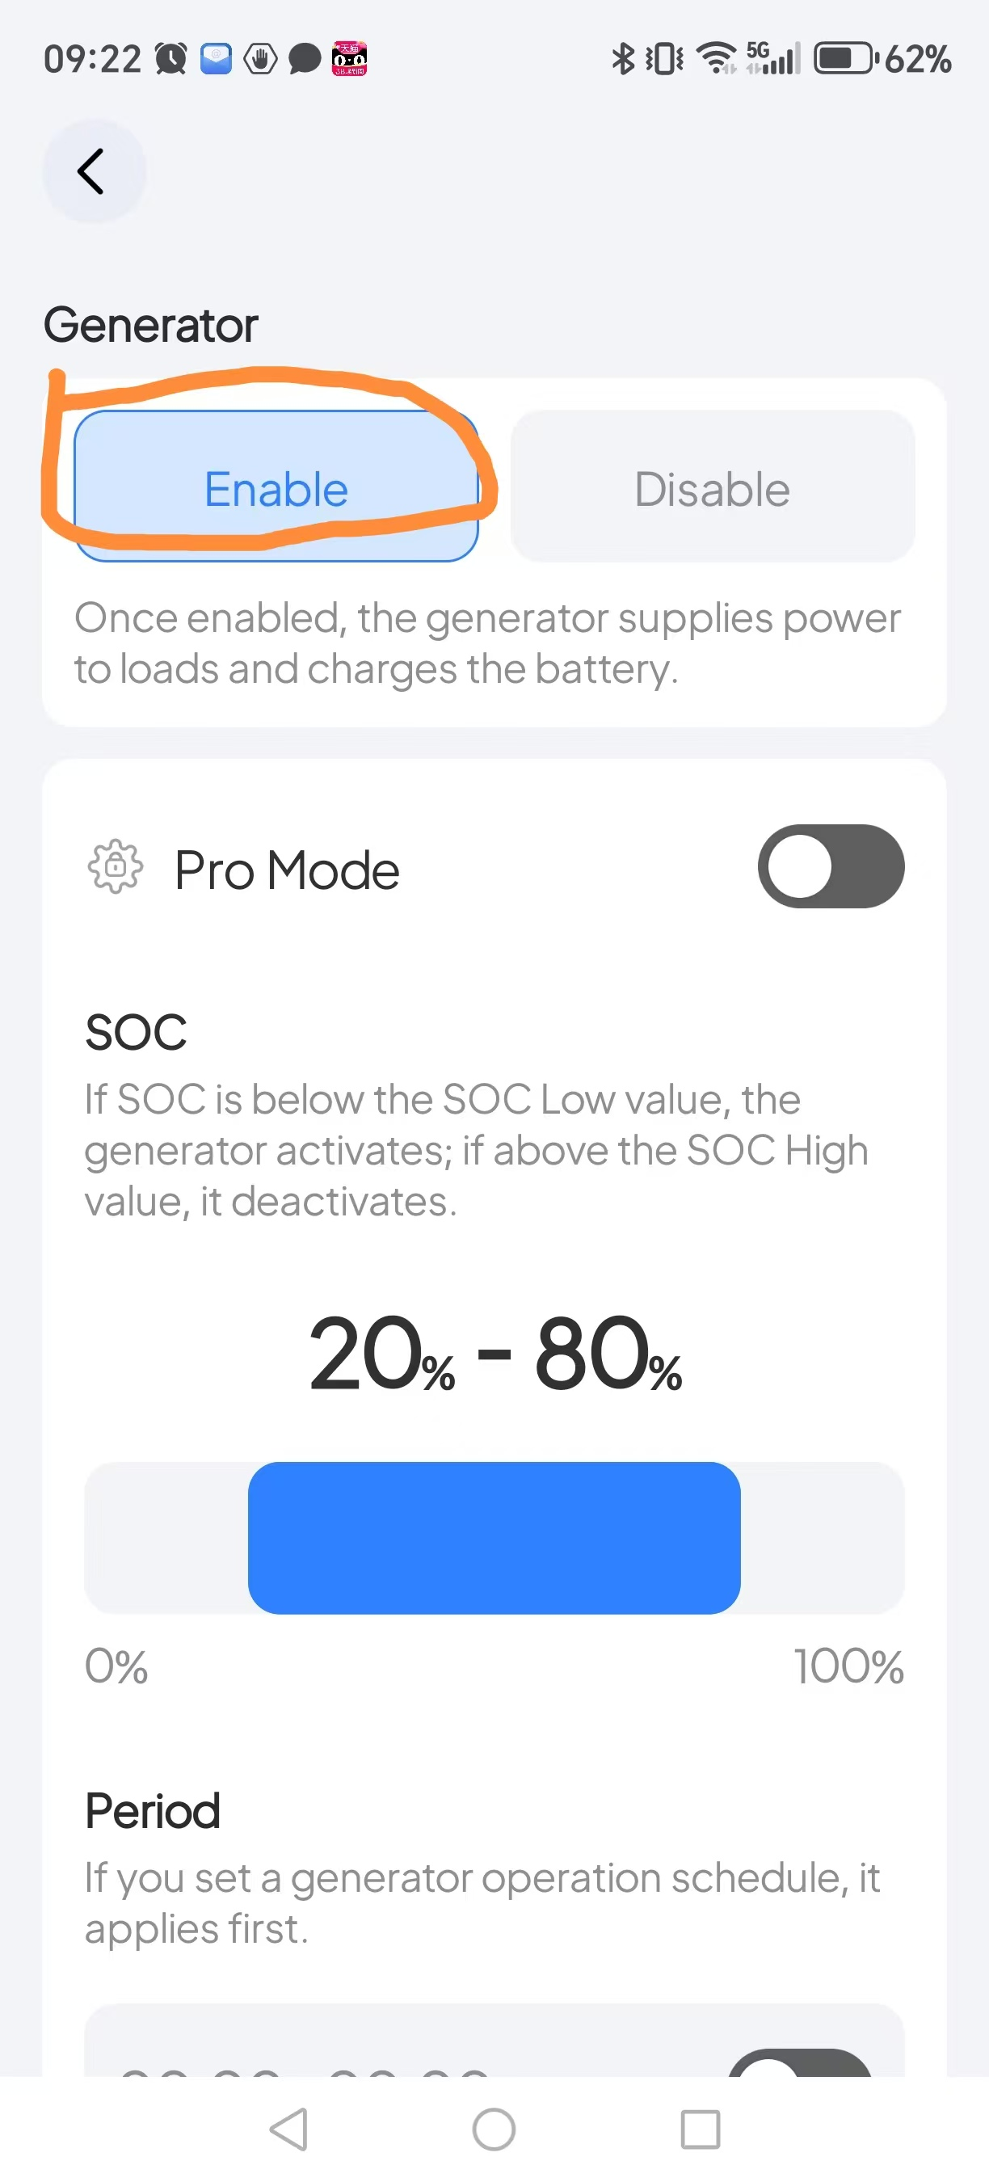
9. Manual Generator solution
APP Setting

Slide 14
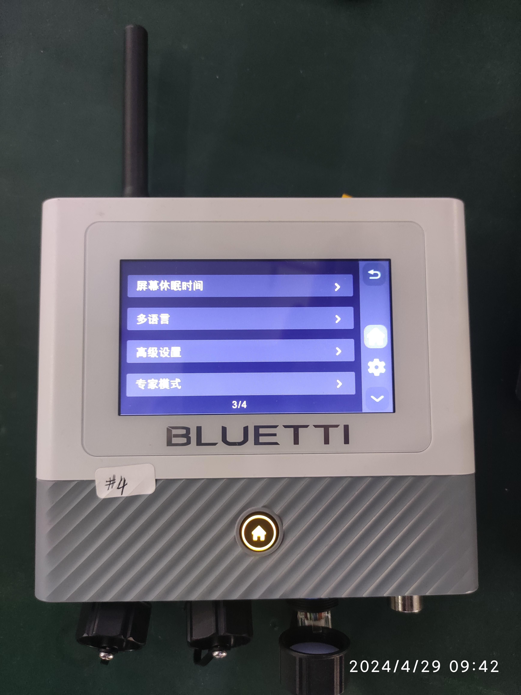
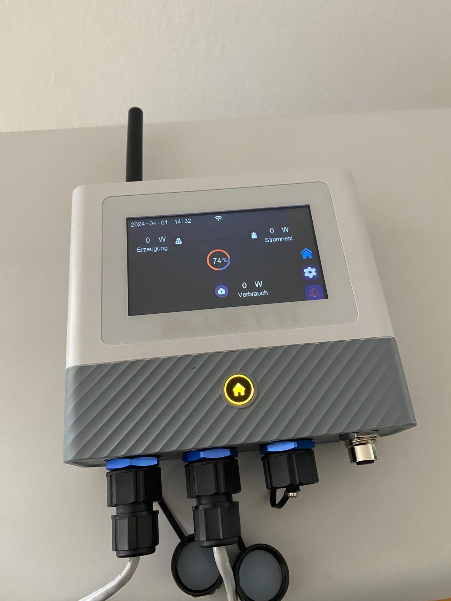
10.EMS Touch screen
Specific application scenarios
If you want to use the touch display screen for convenient operation, easy viewing of machine status and modification of parameters, and intuitive display of machine status, you only need to remove the original IOT Bluetooth WIFI module and replace it with an EMS screen.
Accessory SKU
19.0704.0267-00(EMS without meter)
19.0704.0296-00(EMS with meter for AC Coupled)

Slide 15
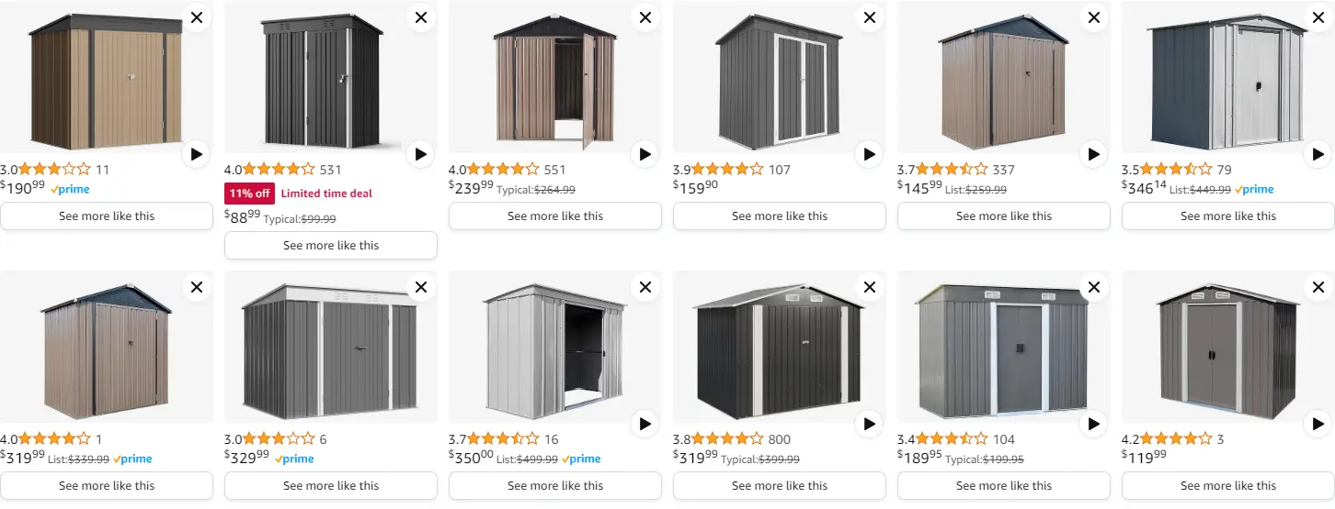
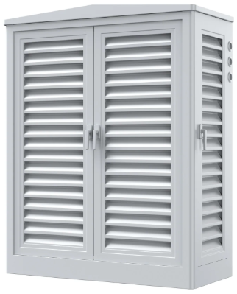
11.Install outside
Specific application scenarios
When the machine is installed outdoors, it needs to install Power Shelter. At present, EP760 in Europe does not have a protective shed like that in the United States, and customers in Europe need to purchase it on Amazon.

